Slide 1
8.1 Programming
The use of basic string handling

Slide 2

String manipulation
String manipulation is the act of manipulating, extracting or changing the characters in a string variable.

Slide 3
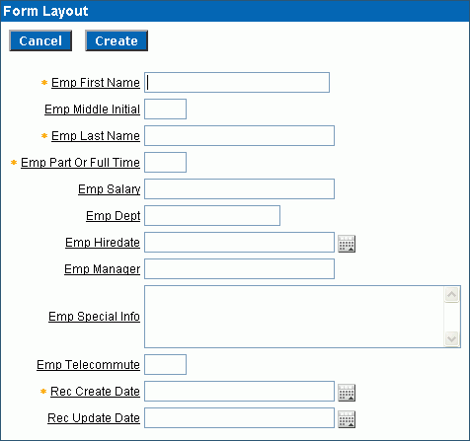
String manipulation
Example 1: An online form
Regardless of how the user inputs their first and last names, the program should store the names internally with the first letter as a capital and the rest in lower case.
So, “crAIG SARGEnt” would become “Craig Sargent”.
This could be achieved by the following steps:
STEP 1: Extract the first letter from the input and convert it to upper case.
STEP 2: Extract all the remaining letters and convert them to lower case.
STEP 3: Join the two parts back together.
crAIg
SARGEnt

Slide 4
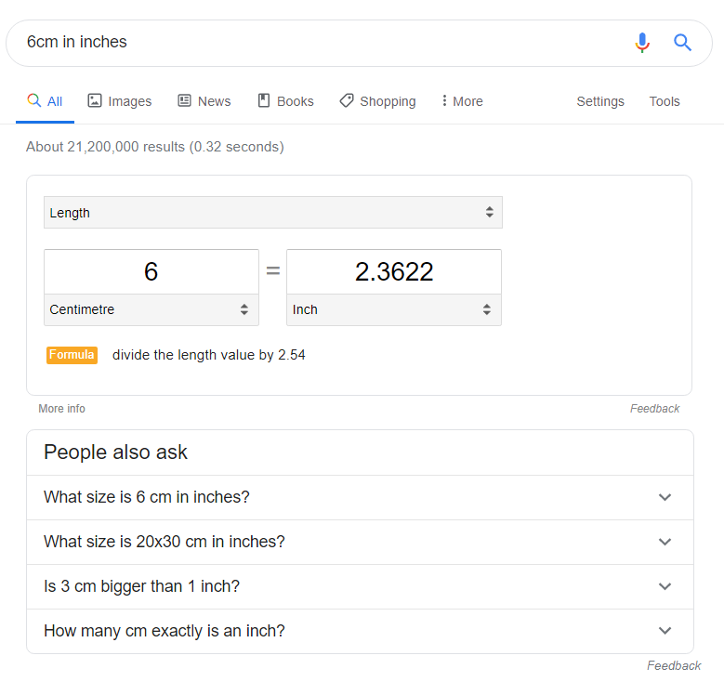
String manipulation
Example 2: Text parsing
You can input phrases into search engines like “6cm in inches”. The search engine then parses this text string and provides a sensible output.
Extract the number 6.
Extract the characters “cm”.
Extract the characters “inches”.

Slide 5
String manipulation commands (Python)
To get the length of a string
Concept | Keyword/Symbol
String length | len()
Returns the length of a string.
length = len(string)
e.g., if string was “Hello”, length would be 5.

Slide 6
String manipulation commands (Python)
To get the length of a string
Concept | Keyword/Symbol
String length | len()
Returns the length of a string.
length = len(string)
e.g., if string was “Hello”, length would be 5.
Converting cases
Concept | Keyword/Symbol
Uppercase | .upper
Lowercase | .lower
Returns the string in upper case or lower case.
ustring = string.upper()
lstring = string.lower()
e.g., if string was “Hello”, ustring would be “HELLO”.
e.g., if string was “Hello”, lstring would be “hello”.

Slide 7
String manipulation commands (Python)
To get the length of a string
Concept | Keyword/Symbol
String length | len()
Returns the length of a string.
length = len(string)
e.g., if string was “Hello”, length would be 5.
Converting cases
Concept | Keyword/Symbol
Uppercase | .upper
Lowercase | .lower
Returns the string in upper case or lower case.
ustring = string.upper()
lstring = string.lower()
e.g., if string was “Hello”, ustring would be “HELLO”.
e.g., if string was “Hello”, lstring would be “hello”.
To get a substring
Concept | Keyword/Symbol
Substrings | string[x:x]
Returns part of a string, starting at the character of the first parameter and counting up by the number in the second parameter.
chars = string[2:3]
e.g., if string was “Hello”, chars would be “l”.

Slide 8

String manipulation commands
Here is an example of how these concepts will look in exam papers following the Cambridge IGCSE pseudocode format, which is listed towards the back of the syllabus.
LENGTH("Happy Days")
will return 10
LCASE(ꞌWꞌ)
will return ꞌwꞌ
UCASE("Happy")
will return "HAPPY"
SUBSTRING("Happy Days", 1, 5)
will return "Happy"
LENGTH (<identifier>)
Returns the integer value representing the length of string.
The identifier should be of data type string.
LCASE (<identifier>)
Returns the string/character with all characters in lower case.
The identifier should be of data type string or char.
UCASE (<identifier>)
Returns the string/character with all characters in upper case.
The identifier should be of data type string or char.
SUBSTRING (<identifier>, <start>, <length>)
Returns a string of length <length> starting at position <start>.
The identifier should be of data type string, length and start should be positive and data type integer.
String operations
String operations

Slide 9


